Slide 1
TABLE & FORMS
DAY 4

Slide 2
TABLE
The table is one of the most useful constructs.
Tables are all over the web application.
The main use of the table is that they are used to structure the pieces of information and structure the information on the web page.
An HTML table is a table-based page layout.
.

Slide 3
Table tags
The <table> tag is used to create a table.
In HTML, a table is considered as a group of rows containing each group of cells.
There can be many columns in a row.
HTML tables should be used for tabular data only, but they are also used for creating layout web pages.
If we build HTML tables without any styles or attributes in the browser, they will be displayed without any border.
Table tag : <TABLE> </TABLE>
The content which we write between these tags will be displayed within the table.

Slide 4
1. <thead> Tag
The <thead> defines a set of rows defining the head of the columns of the table.
Syntax:
<thead></thead>

Slide 5
2. <tbody> Tag
The <tbody> tag is used to group the body content in the HTML table.
Tables can contain more than one body; in some tables, in the other case, the table can contain only one body; in those cases, the <tbody> can be removed.
Tables with one body will have an implicit body.
Syntax: <tbody> </tbody>

Slide 6
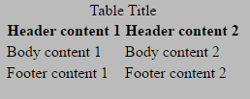
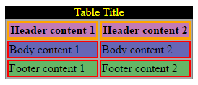

Slide 7
3. <tfoot> Tag
The <tfoot> tag contains rows that represent a footer or summary.
Syntax:
<tfoot> </tfoot>

Slide 8
4. <tr> Tag
The <tr> tag is used to define a row in the HTML table.
Starts the row with the beginning by <TR> row tag and then build the row by creating each cell, and when finish all the cells for a row, then close the row with the ending row tag </TR>.
Row tag : <TR> </TR>

Slide 9
5. <td> Tag
The <td> tag is used to define the data for the cell in the HTML table.
We will create each cell with the beginning cell tag <TD> and then add the content or data to the cell and then close the cell with the ending cell tag </TD>.
Cell tag : <TD> </TD>

Slide 10
6. <th> Tag
The <th> tag is used to define the header cell in an HTML table.
The header cell in the table is used to provide information for the remaining cells of the column.
Header tag : <TH> </TH>

Slide 11
7. <bgcolor> Tag
The <bgcolor> tag is used to specify the background color of the table.
Syntax: <table bgcolor = "color_name">
For the color name, we can directly provide the color name for the background.
For example <table bgcolor =”Red”>

Slide 12
8. <caption> Tag
The <caption> tag is used to provide the caption to the table.
It is placed or used immediately after the <table> tag.
By default, the table caption will be center-aligned above the table.
Caption tag : <caption> </caption>

Slide 13
9. Cell Spanning
Spanning is nothing but combining two or more adjacent cells in the table.
It consists of col span and row span.
Col span: The col span attribute specifies the number of columns a table cell should span.
<td col span = “number”>
It always takes an integer value.
Row span: The row span attribute specifies the number of rows a table cell should span.
<td row span = “number”>
It always takes an integer value.

Slide 14
FORM
form is used to collect user input. The user input is most often sent to a server for processing.
<form> element is used to create an HTML form for user input.
Eg: <form>
<!--form elements-->
</form>

Slide 15
FORM ELEMENTS
<label>: It defines label for <form> elements or to display the text as label.
<input>: It is used to get input data from the form in various types such as text, password, email, etc by changing its type.
<button>: It defines a clickable button to control other elements or execute a functionality.
<select>: It is used to create a drop-down list.
<textarea>: It is used to get input long text content.
<option>: It is used to define options in a drop-down list.

Slide 16
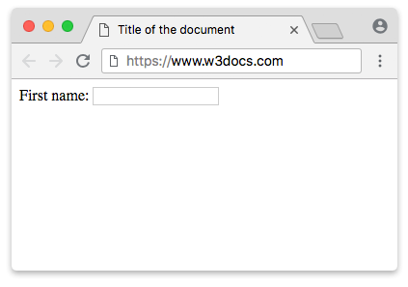
LABEL
The <label> tag defines a label for many form elements.
<lable for="">Username</label>
Set the identifier (id) inside the <input> element and specify its name as a for attribute for the <label> tag.
<label for="lfname">First name:</label>
<input id="lfname" name="fname" type="text" />

Slide 17
INPUT TAG
An <input> element can be displayed in many ways, depending on the type attribute.
<input type="text"> Displays a single-line text input field
<input type="radio"> Displays a radio button (for selecting one of many choices)
<input type="checkbox"> Displays a checkbox (for selecting zero or more of many choices)
<input type="submit"> Displays a submit button (for submitting the form)
<input type="button"> Displays a clickable button

Slide 18
SUBMIT BUTTON
-The <input type="submit"> defines a button for submitting the form data to a form-handler.
<input type="submit" value="Submit">
or
<button type="Submit"> Login</button>

Slide 19
REGISTRATION
<input type="button">
<input type="checkbox">
<input type="color">
<input type="date">
<input type="email">
<input type="file">
<input type="hidden">
<input type="image">
<input type="month">
<input type="number">
The default value of the type attribute is "text".
<input type="radio">
<input type="range">
<input type="reset">
<input type="search">
<input type="submit">
<input type="text">
<input type="time">
<input type="url">
<input type="week">
<input type="password">

Slide 20
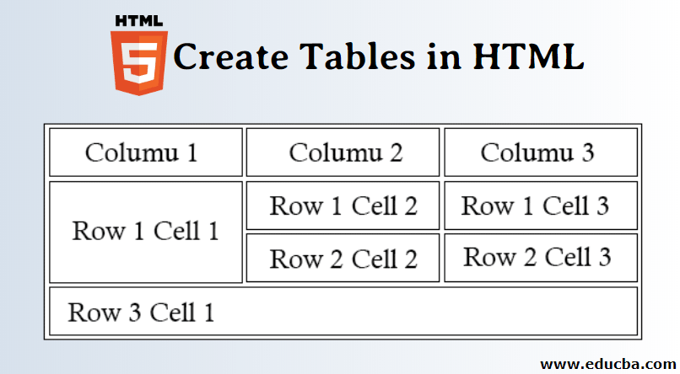

Slide 21
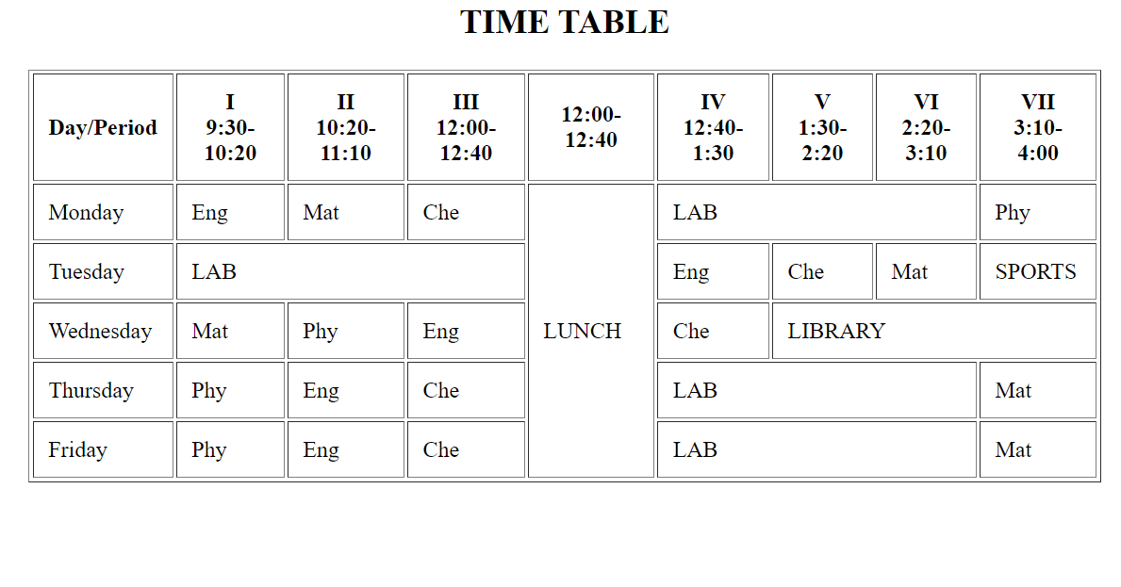
TASK 1

Slide 22
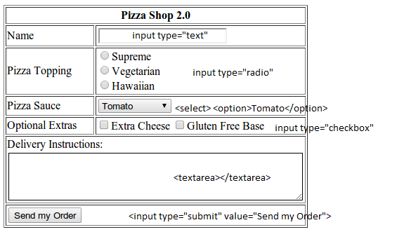
TASK

Slide 23
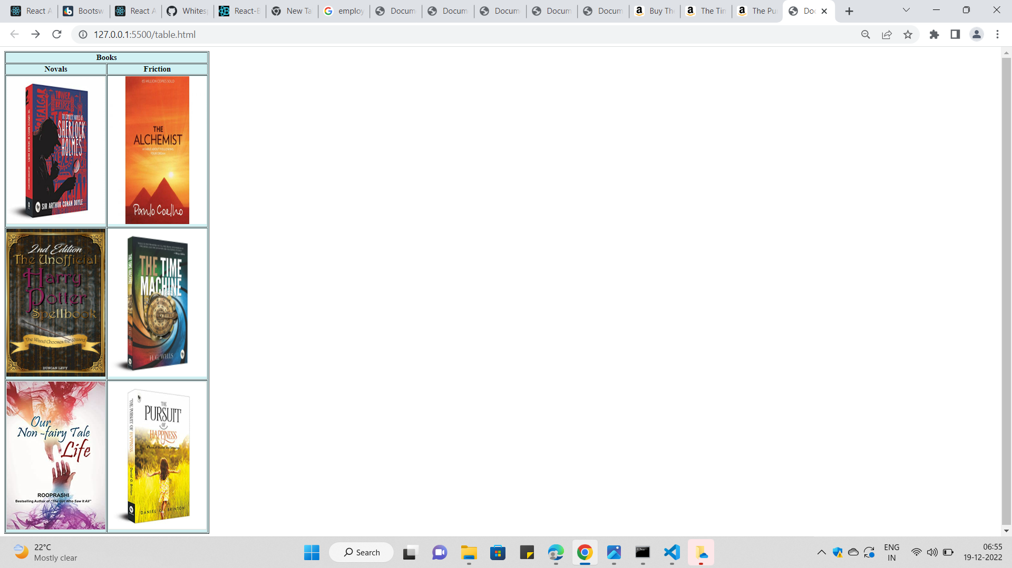
TASK 2

